Slide 1
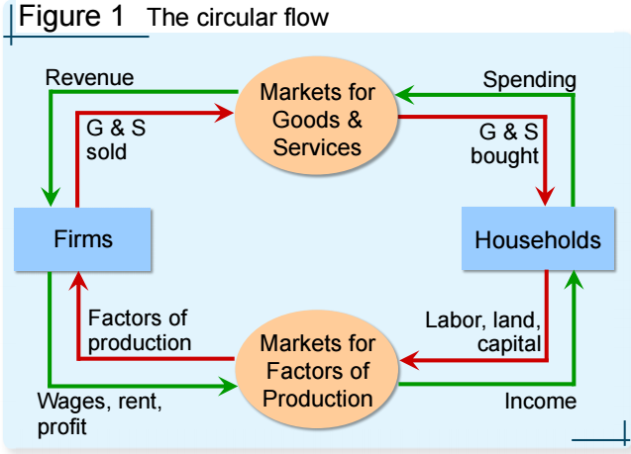
Ch 2. Thinking Like an Economist
Economists play two roles, Scientists and/or Policy advisors
Economists use assumptions and models to study economic issues
1. Circular-flow diagram
  Visual model of the economy, Shows how dollars flow through markets among households and firms
  Two decision makers –Firms and Households
  Interacting in two markets
  1) Market for gods and services
  2) Market for factors of production (inputs): labor, land, capital
2. Production Possibilities Frontier, PPF
  A graph: combinations of output that the economy can possibly produce
  Given the available factors of production and technology
  Example: Narnia Land
  producing computers and wheat, with one resource(50,0000 Labor hours), Producing one computer requires 100 hours labor.
  Producing one ton of wheat requires 10 hours labor

Slide 2
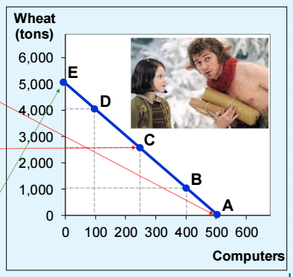
Points on the PPF (like A – E): possible & Efficient: all resources are fully utilized
Points under the PPF (like F): possible but Not efficient: some resources are underutilized (e.g., workers unemployed, factories idle)
Points above the PPF (like G) – Not possible
Moving along a PPF
The slope of the PPF : The opportunity cost of one good in terms of the other
Economic Growth and the PPF : With additional resources or an improvement in technology, the economy can produce more
Shape of the PPF
Straight line: constant opportunity cost
Previous example: the opportunity cost of 1 computer is 10 tons of wheat
Bowed outward: increasing opportunity cost
As more units of a good are produced, we need to give up increasing amounts of the other good produced

